Slide 1

THYROID HORMONE & ANTI-THYROID DRUGS
Dr. K.K. Mishra
Assistant Professor
S.K.M.C.H. Muzaffarpur

Slide 2
ANTI THYROID DRUGS:-
Antithyroid drugs are those drugs which lowers down level of circulatory thyroid hormone by different mechanism.
Depending upon their mechanism of action they are classified. They can destroy thyroid tissue directly, or inhibit release of hormone, or inhibit synthesis of hormone.
Thyroid inhibitors are classified into four main category.

Slide 3
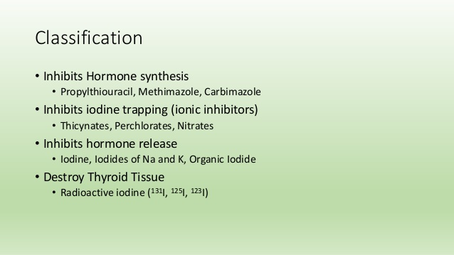
CLASSIFICATION OF THYROID INHIBITORS:-

Slide 4
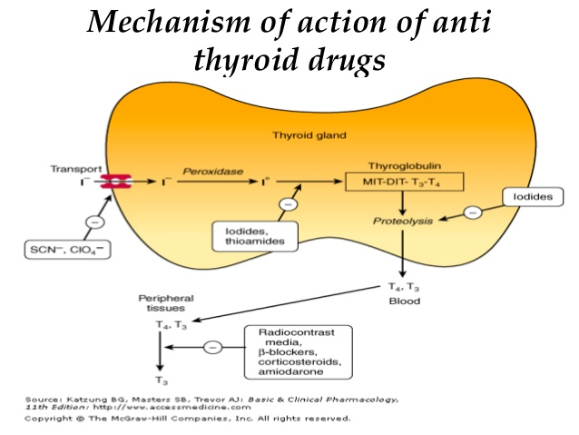

Slide 5
HORMONE SYNTHESIS INHIBITOR:-
These drugs belong to thionamide group of drugs. Propylthiouracil is prototype drug of this group.
MECHANISM OF ACTION:-
These drugs inhibit the enzyme peroxidase involved in the process of iodination of tyrosine in thyroglobulin & subsequent coupling reaction.
Additionally peripheral conversion of T4 to T3 is also inhibited by propylthiouracil but not by other drugs of this group.

Slide 6
Onset of action requires about 3 to 4 weeks. This is the time required for depletion of stored hormone.
As propylthiouracil also inhibit peripheral conversion so it acts faster than other & some time used for treatment of severe hyperthyroidism.
Carbimazole is 3 times more potent than propylthiouracil.

Slide 7
PHARMACOKINETICS:-
These drugs absorbed rapidly on oral administration widely distributed & concentrated in thyroid gland.
Plasma half life of PTU is 75 minutes, while of carbimazole is 6-8 hours. plasma half life is short but effect is longer due to accumulation of drug in thyroid gland.
Carbimazole converted into active metabolite methimazole for action.
PTU strongly bound to plasma protein so less amount cross placenta (can be used in pregnancy), while carbimazole less bound readily cross placenta & secreted in milk.
Most amount excreted in urine after glucuronide conjugation .

Slide 8
CLINICAL USES:-
To achieve spontaneous remission & control of thyrotoxicosis in-
1.grave’s disease- these are preferd drug in young patients & remission occur in most patients within one year. Dose range from 150 – 400 mg/day in divided dose. The dose may be reduced in 10 to 12 weeks when patient become euthyroid.
2. Toxic nodular goitre- treatment of choice is surgical excission but these drug may be used in whom surgical excission or radioactive iodine can not be used.

Slide 9
3. Used together with radioactive iodine- radioactive iodine administration leads to severe exacerbation of hypothyroidism. To prevent this these drugs are used prior to deplete the hormone stores.
4. Preoperative control of hyperthyroidism-

Slide 10
ADVERSE EFFECT:-
hypothyroidism- due to over treatment leads to increase TSH level & enlargement of thyroid gland. These revert back on stopping drug.
Skin rash- urticaria & purpural rashes appear, that disappear on stopping drug.
Uncommon s/e- nausea, headache, joint pain, skin pigmentation.
Rare s/e- granulocytopenia, hepatitis & nephritis more common with PTU.

Slide 11
IODINE & IODIDES:-
Iodine is the oldest & fastest acting agent available for treatment of hyperthyroidism.
Although iodine is required for synthesis of hormone, it also inhibits the thyroid function (paradoxical effect)
The effect depends upon the dose of iodine. In lower dose it stimulates hormone synthesis, but at higher dose >than 6mg(more than 40 times RDA ) inhibit thyroid function.

Slide 12
MECHANISM OF ACTION:-
The higher dose of iodine inhibits all the stages of hormone synthesis from iodine trapping to release of hormone. Most effective is release of hormone. Inhibits hormone release in hyperthyroid & euthyroid patients.
Iodine administered orally converted into iodide in gut.
The effect of continuous administration of iodide on thyroid gland is usually manifested in 24 hours & peak reaches in 10 -14 days, but complete control not achieved.

Slide 13
EFFECT OF IODINE ON THYROID GLAND:-
Due to inhibition of hormone by thyroid gland the thyroid gland shrinks (cell become smaller), become firm (due to accumulation of colloid), & less vascular. This is called thyroid constipation.
On continuous treatment there is loss of therapeutic effect (thyroid escape) & hyperthyroidism reappear & is more severe this time.
Due to this reason iodides are used only in preoperative preparation of thyroid gland.

Slide 14
THERAPEUTIC USES:-
Preoperative preparation- in patient of hyperthyroidism undergoing thyroidectomy operation. Administered usually 7-10 before surgery to make gland firm, small, less vascular easier to operate. Euthyroidism in such patient is achieved by using carbimazole, for CVS symptom propranalol and diltiazem can be used.
Endemic goitre- iodine is added in food item like salt & rice in small amount to prevent hypothyroidism.

Slide 15
3. Thyroid storm-
4. Cough expectorant-
5. As antiseptic- in the form of tincture iodine, povidone iodine, lugol’s iodine.
ADVERSE EFFECT:-
1. On acute administration- hypersensitivity reaction may develop in sensitive person. The manifestation are swelling of lip and eye lids, laryngeal edema, angioedema, multiple cutaneous hemorrhage, fever, arthralgia, lymphadenopathy may occur. Acute or chronic such reaction called iodism.

Slide 16
2. On chronic uses- mild iodism mimic symptom of common cold like rhinorrhea, lacrimation, sneezing, swelling of eye lids. Other symptoms are skin rashes, burning mouth & throat, tenderness of teeth & gum. Some times severe headache, increased bronchial secretion, tender enlarged parotid & maxillary gland may occur.
Prolonged administration also lead to hypothyroidism and goitre. The symptoms of iodism resolve spontaneously on stopping drug.

Slide 17
RADIOACTIVE IODINE:-
There are several isotopes of iodine
MECHANISM OF ACTION:-
the radioactive iodine administered orally is concentrated in thyroid gland & actively taken up by thyroid follicular cells, incorporated in into iodotyrosine & deposited in colloid.
Where it emits two types of radiation beta rays & gama rays.
The parenchymal cells of thyroid are destroyed by beta rays from within to outside with negligible or no damage to surrounding tissues.

Slide 18
The destruction depends upon the dose of radioactive iodine (smaller dose does not destroy the periphery of gland, larger dose causes complete destruction of gland). Necrosis of follicular cells occur and fibrosis of gland takes place.
Thus if the dose is calculated meticulously thyroid gland can be destroyed partially or completely as per treatment requirement without any damage to adjacent tissues.
The gamma particles is useful in thyroid scanning and tracer study.

Slide 19
ISOTOPES OF IODINE-
I-123 & I-131 are commonly used isotopes.
I-123- half life 13 hours , mainly emits gamma rays so useful in thyroid scanning and tracer studies.
I-131- most commonly used having half life of 8 days. Emit both beta & gamma rays . So suitable for both tracing study & treatment. Used as sodium salt which is taken by oral route after dissolving in adequate amount of water.

Slide 20
THERAPEUTIC USE:-
The dose of radioactive iodine depends upon the size of gland which is calculated by ultrasonography. Optimal dose is 75 to 150 microcurie/gm of thyroid tissue.
Hormone synthesis inhibitors like methimazole also used before iodine administration to prevent hyperthyroidism. As radioactive iodine leads to radiation thyroiditis and severe increase in hormone level.
The synthesis inhibitor must be stopped one week prior to administration of radioactive iodine.
After administration of radioactive iodine antithyroid drugs again started after one week.
Beta blockers are used to control symptom of hyperthyroidism.

Slide 21
INDICATIONS:-
Hyperthyroidism due to any reason
Grave’s disease where antithyroid drug fail to produce effect after prolonged treatment
Elderly patient & in whom thyroidectomy is not possible
Patients with existing heart disease
Toxic nodular goitre poorly responding to antithyroid drugs.
Multinodular goitre producing symptom due to compression of adjoining structure and can’t be operated

Slide 22
ADVANTAGE:-
Cost of therapy is low.
Hospitalization not required , can be given on out patient basis.
Control is permanent, recurrence not occur
Less chance of complication compared to surgery like surgical scar, damage to parathyroid, injury to recurrent laryngeal nerve.

Slide 23
DISADVANTAGE:-
Permanent hypothyroidism occur in some cases , life long hormone supplementation required in such cases.
Delayed onset of action so other drugs needed in between the window period.
Cannot used during pregnancy as fetal thyroid may get damage causes congenital hypothyroidism.
Preferably not used in young patients less than 30 years

Slide 24
Other drugs used in hyperthyroidism:-
1. to control cardiac stimulant effect:-
beta blockers- propranolol, atenolol, esmolol, these agents are used to control symptom of thyrotoxicosis like tachycardia, palpitation, tremors. In hyperthyroidism there is increase number of beta receptors and their sensitivity increased so these drugs used .
Calcium channel blockers:- diltiazem & verapamil are also used to control above symptoms.

Slide 25
2. corticosteroids:- dexamethasone inhibits release of thyroid hormone & peripheral conversion of T4 to T3.
3 cholestyramine:- cholestyramine binds with thyroid hormone in gut & prevents it enterohepatic circulation.

Slide 26
THANK YOU

